Slide 1



Infrastructure Overview
and Current Themes
October 31, 2014
Steven Grossman, Treasurer and Receiver General, Chair
Michael G. Trotsky, CFA, Executive Director and Chief Investment Officer

Slide 2
Overview

Slide 3
Defined
Portfolio Contribution
Predictable income.
Uncorrelated asset class.
Inflation protection (but not well tested).
Low volatility.
Investment Characteristics
Essential to society.
Long life assets.
High barriers to entry - Monopoly businesses (regulatory, contractual, economic/capital).
High regulation.
Heterogeneous – can diversify with limited amount of assets.
Limited risk of obsolescence but potential for large capital outlays.
Local benefits.

Slide 4
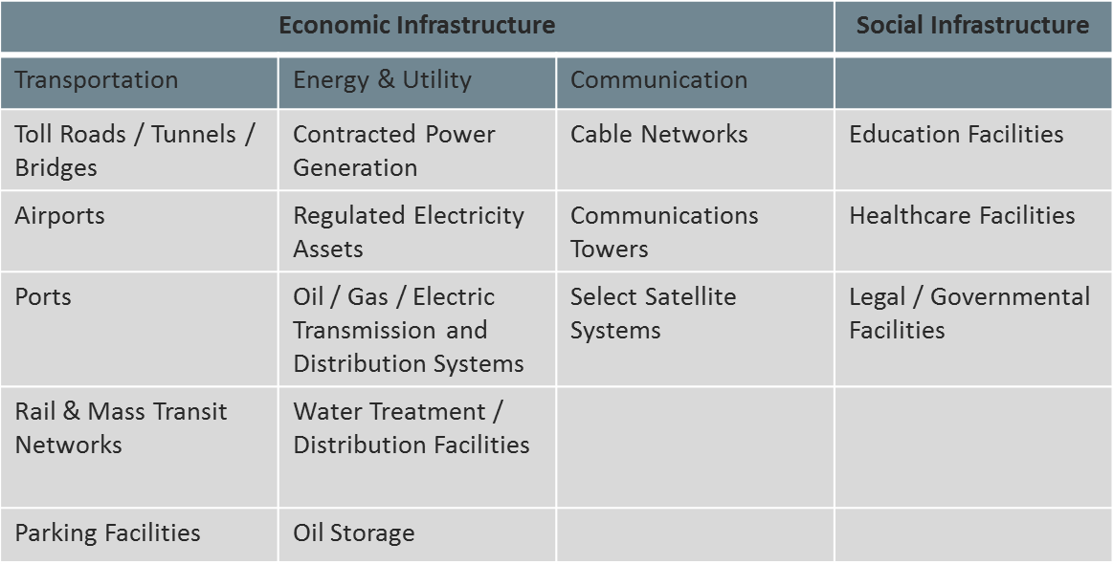
Strategies
Infrastructure is a broad category

Slide 5
Market Size (by region)
Source: OECD, World Bank, Stanford University (2010)

Slide 6
Risk Factors
Regulatory –
Price capping lowers profits (most common in non-democratic countries).
This risk can be significant. Focus on varied regulatory and political environments.
Commodity Risk – Profit impact. Issue in energy production and exploration, airlines, transportation, etc.
Duration risk (Long term contracts) – mitigate through well structured contracts.
Illiquidity – Can be solved through listed company investments. Should improve as private markets develop.
Operational – Individual investment dependent.
Political – “Regime” changes can bring different views to infrastructure spending.
War – Infrastructure facilities are priority targets.

Slide 7
Representative Infrastructure Investors
U.S. Public Pension Funds.
CalPERS, CalSTRS.
Florida.
Texas Teachers.
Oregon.
Washington.
New York Common (check this).
Maine.
Virginia.
Infrastructure investing is considerably more prevalent with Australian, Canadian and European Institutions.

Slide 8
Current and Target Investor Allocations
Source: Preqin, CBRE Clarion

Slide 9
Asset Class Behavior

Slide 10
Asset Class Performance (Listed)
Source: Evestment

Slide 11
Private Market Returns
Preqin data (above) is widely viewed as the primary data source for private market performance data.
As illustrated, this data is limited and variable.

Slide 12
Correlation Matrix
Source: Evestment

Slide 13
Listed Benchmark Overview
Source: Bloomberg, FTSE, S & P, Dow Jones, Centersquare

Slide 14
Expected Returns (Asset Level)
Source: J.P. Morgan, Townsend Group

Slide 15
Market Themes

Slide 16
Drivers of Investment Opportunities
Government budget deficits.
High debt levels.
Tax policy.
Regulatory environment and views on public/private partnerships.
Deferred capital investment - Aging stock (developed countries).
Impact to economic growth.
Public and business sentiment key.
Economic growth.
Quantitative easing (region specific).
Urbanization.
Emerging economies – services to growing middle class.

Slide 17
Regional Themes
U.S./North America
The U.S. lags in infrastructure investment and PPP – U.S. investors will likely need to look outside their home country.
Investment needed across categories (deferred capex).
Storing and getting oil and gas from extraction point (i.e. Texas, PA) to demand points (pipelines, roads ).
European Union
Cooperative process amongst countries to identify projects.
Gas pipelines (look at geopolitical issues)
Government budgets stressed – Privatizing assets, strong investor interest
Highest transaction activity (approximately 50% of world)
Asia and India
Strong airline passenger growth
Mobile and internet data (cell towers)
Japan – stimulus leading to investment
China?

Slide 18
Capital Flows
$300 billion plus globally transacted in 2013, $400 billion plus in 2014 YTD.
Europe - 55% (2013).
North America – 22%.
Asia – 9%.
Other – 14%.
Strong capital flows in Q3.
55% of deals over $100 million in size (2013), 11% > $1B.
Sectors well balanced – Renewable energy notably strong at 29%.
Source: Preqin

Slide 19
Some Infrastructure Starting Metrics
Infrastructure grades by country, type – (OECD, World Bank, ASCE).
Investment spending overall and as a % of GDP.
Population Ratios.
Cars.
Total length of roads, rail.
Hospital beds.
Telephone users.
Internet users.
Flights – population ratios.
Electricity consumption.
Sanitation facilities.

Slide 20
Implementation

Slide 21
Structural Investment Options
Listed securities/MLP’s.
Liquidity.
Higher equity correlation and volatility.
Existing professional management and asset base.
100-200 “pure play” companies.
Private equity (funds).
High fees.
Illiquid, lack of control (but presumably strong management).
Approximately 300 managers in market – 30 to 50 worth considering.
Fund of fund.
Multiple layers of fees.
Direct.
Concentration risk – likely requires partners.
Greater control and transparency.
Co-invest.
Lower fees.
“Built in” manager and fiduciary.
Risk of forced liquidation.
Lack of control.

Slide 22
Implementation Considerations
Portfolio role – inflation hedge? Test this and invest accordingly.
PRIM already has infrastructure investments in it’s PE portfolio.
Structure – see prior page.
Leverage.
Portfolio Construction.
Investment size.
Control preference – partnerships common.
Fees – PE fees worth it for return?.
Procurement.
Staffing.

Slide 23
Next steps
There is much more to learn about infrastructure:
Engage other collaborators within PRIM.
Develop view of key valuation measures and current valuation environment.
Conduct a deeper dive of the individual infrastructure strategies.
Conduct a more detailed analysis of private benchmark performance (Preqin).
Source and talk to key contacts at peer investors and investment firms.

